Slide 1
Memahami Fenomena dan Desain Tema Riset Akuntansi
Oleh:
Dr. Unti Ludigdo, Ak
Fakultas Ekonomi dan Bisnis Universitas Brawijaya
unti_akuntansi@ub.ac.id dan masunti@gmail.com
Disampaikan pada
Accounting Research Traning Series Volume 2 “Metode Riset Kualitatif “
JAFEB-UB, 7-8 Desember 2011

Slide 2
Prolog
Secara kelembagaan JAFEB-UB telah turut mengembangkan disiplin akuntansi dengan ragam pendekatannya (Akuntansi Multiparadigma) melalui diskusi, riset dan publikasi yang dilakukan oleh dosen dan mahasiswanya pada semua jenjang pendidikan dengan mengaitkannya pada tema-tema lokal keindonesiaan.
Tantangannya adalah apakah pemanfaatan pendekatan multiparadigma ini hanya dapat dilakukan oleh JAFEB-UB, dan kemudian apakah kita mempunyai keyakinan bahwa nilai-nilai keindonesiaan dapat mendasari pengembangan disiplin akuntansi?

Slide 3
Makna Riset
Bagi akademisi, dalam mana semestinya dia juga sebagai ilmuwan-cendekiawan, riset semestinya menjadi ajang perjuangan dan penuangan idealisme untuk berkontribusi dalam peningkatan kualitas ilmu pengetahuan yang kemudian berdampak pada meningkatnya martabat kehidupan.
Riset, pada tataran tertentu, seharusnya melahirkan temuan-temuan baru ataupun setidaknya menutupi kekurangan bangunan teori sebelumnya yang sekiranya akan berdampak lebih positif untuk peningkatan kualitas kehidupan.

Slide 4
Karakteristilk
Riset
Dasar Paradigma
Metodologi Riset Kualitatif
Desain Riset
Teori Penunjang:
Fenomenologi
Etnometodologi
Hermeneutika
Interaksi Simbolik
Strukturasi
Institusional
Feminisme
dll.
Teori /Konsep/
Model

Slide 5
Karakteristik Riset Kualitatif
Bukan untuk generalisasi
Konteks natural/alamiah
Manusia sebagai instrumen
Pemanfaatan pengetahuan tak terkatakan (tacit knowledge)
Desain sementara
Metode kualitatif
Sampel purposive
Analisis data induktif
Hasil yang disepakati
Penafsiran ideografik

Slide 6
Mengeksplorasi
Latar belakang Riset
Merumuskan
Fokus & Tujuan Riset
Mereview
Literatur/Teori
Mengumpulkan
Data
Menganalisis
Data
Narasi Riset

Slide 7
I. LATAR BELAKANG
Sebagai uraian konteks riset
Menjawab pertanyaan mengapa riset atas suatu fenomena (permasalahan) akuntansi dilakukan
Menjelaskan informasi awal atas suatu fenomena akuntansi yang bersumber dari pengamatan, percakapan intens dengan orang-orang tertentu atau pelaku suatu tindakan sosial, jurnal, media massa, laporan riset
Menjelaskan keunikan riset dan posisi riset di antara riset yang sudah ada
Sebagai dasar penentuan fokus riset

Slide 8
Fenomena (akuntansi) yang Bagaimana (?)
Mengisyaratkan nilai temuan yang signifikan dan bermanfaat bagi pengembangan ilmu pengetahuan maupun pemecahan masalah dalam suatu masyarakat
Merupakan fenomena baru yang unik
Mengisyaratkan adanya “ketidakberesan” dalam akuntansi
Fenomena tersebut dimungkinkan untuk diteliti
(= waktu, biaya, kapasitas diri peneliti)

Slide 9
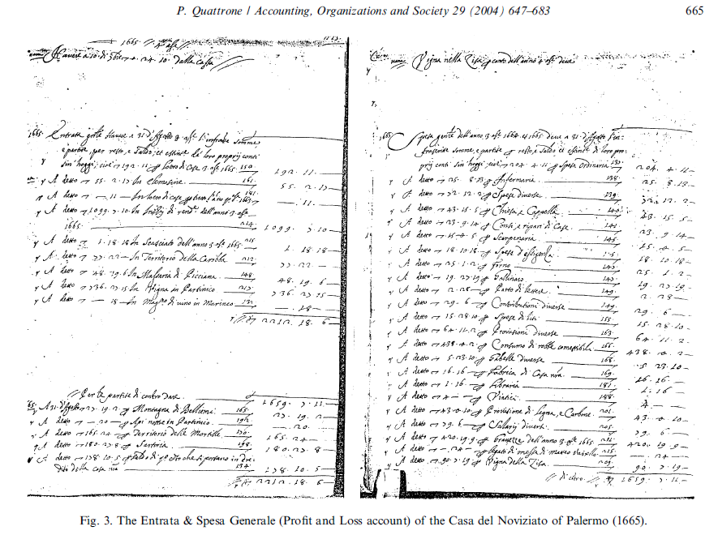

Fenomena Akuntansi dan Ide Riset?

Slide 10
Sebuah Pendapat dari Mautz
(dikutip oleh Belkaoui, 1996; h. 2)
“Akuntansi berhubungan dengan perusahaan, yang mana tentu saja adalah suatu kelompok sosial; ia berhubungan dengan transaksi-transaksi dan kejadian ekonomi lain yang mempunyai konsekuensi sosial dan memengaruhi hubungan sosial; ia menghasilkan pengetahuan yang berguna dan bermakna bagi manusia yang terlibat dalam aktifitas yang berimplikasi sosial; ia terutama berkaitan dengan persoalan mental. Berdasar pedoman-pedoman yang ada, akuntansi adalah suatu ilmu sosial”

Slide 11
Akuntansi… (?)
Keseluruhan aktifitas akuntansi meliputi pengumpulan dan analisa informasi yang berguna bagi orang-orang yang harus mengambil keputusan (Carsbeg, 1984).
.

Slide 12
Akuntansi… (?)
Faktor-faktor manusia dan sosial merupakan hal yang paling penting dari aspek desain dan operasi sistem akuntansi (Hopwood, 1974; 1-2).

Slide 13
Akuntansi… (?)
Sistem akuntansi dipakai untuk tujuan-tujuan individu, organisasi dan sosial, yang mana mereka diakui sangat berpengaruh terhadap akuntansi sebagaimana sebaliknya mereka juga dipengaruhi oleh akuntansi (Parker et al., 1989; 6).

Slide 14
ACCOUNTABILITY VERSTEHEN: A STUDY OF ACCOUNTING
IN STATE RELIGIOUS COUNCILS IN MALAYSIA
[Abdul Rahim Abdul-Rahman (Department of Accounting, Kulliyyah of Economics and Management Sciences, International Islamic University Malaysia) and Andrew Goddard (Division of Accounting and Finance, School of Management, University of Southampton)]
Abstract from Discussion Papers in Accounting and Finance March 2003:
This paper reports in-depth case studies of financial management and accounting practices in two Islamic religious, public service organisations in Malaysia, using a grounded theory methodology. There are two main purposes of the paper. The first is to provide an example of how a grounded theory study is undertaken in practice and to encourage its use in similar and different settings. The second is to contribute to the understanding of financial management and accounting in religious, public service organisations in general and in Islamic organisations in particular. The methodology used was a combination of Strauss and Corbin (1990, 1998) and Glaser (1978). The grounded theory which emerged used Webers (1947,1949,1968) concept of verstehen to explain the differences in accounting practice. The study showed that the broader social, historical and religious contexts in which organisations are embedded, together with the power relationships within them, resulting in unique accounting verstehen and also therefore in unique accounting ractices.

Slide 15
Protecting agricultural accounting in the UK
[by Lisa Jack (Department of Accounting, Finance and Management, University of Essex)]
Abstract from Accounting Forum 30 (2006) 227–243:
This paper examines a particular accounting practice prevalent in the UK agriculture industry and reveals the ‘canopy of legitimations’ that appears to protect the practice and make it highly resistant to change. Agricultural gross margin accounting was innovated through Government sponsored agricultural extension programmes in the post-war period in Britain. The practice is not maintained primarily by farmers but rather by actors within Government agencies and agricultural service industries (including management consultants). New Institutionalism in Sociology (NIS) is used as a theoretical framework, and extended to consider the concept of legitimation as a reflexive process. Although the context is specifically UK agriculture, the theme of the protection of accounting methods by Government and other advisors is of more universal interest. The paper adds to the very few studies in the accounting literature that consider the agriculture and food industries

Slide 16
Political ideology and accounting regulation in China
[by Mahmoud Ezzamel & Jason Zezhong Xiao (Cardiff Business School, Cardiff University) dan Aixiang Pan (School of Accounting, Beijing Technology and Business University)]
Abstract from Accounting, Organizations and Society 32 (2007) 669–700:
This paper analyzes the relationship between political ideology and accounting change covering the transition from Maoism to Dengism in China. Under Mao, the ideological principles of class struggle primacy, central planning, and public ownership were mobilized to construct a class view of accounting according to which Western accounting concepts were prohibited because they were considered a tool of capitalist exploitation. Under Deng, the new ideological principles of economic development primacy, marketization, and mixed-ownership paved the way for a different view of accounting to emerge. Accounting was re-presented as a science and a neutral technology with no national boundaries, and the adoption of what were deemed Western accounting concepts, such as conservatism, was encouraged. In both eras, accounting was construed as a malleable object shaped by the force of the dominant political discourse. We show how in each era political ideology created a context that was rendered more or less compatible with the adoption of particular accounting concepts.

Slide 17
Accountics: Impacts of internationally standardized accounting on the Japanese socio-economy
(by Tomo Suzuki, SAID Business School, University of Oxford, United Kingdom)
Abstract from Accounting, Organizations and Society 32 (2007) 263–301:
This is a case study of the dissemination of internationally standardized accounting to a nation where standardized accounting was hitherto only loosely practiced under domestic conditions. Soon after World War II, a growing interesting socio-economic management, rather than microeconomic or corporate financing, accelerated the implementation of standardized accounting in Japan. In order to make unintelligible delineations of the economy and its constituent firms comprehensible, official and governable, both national and corporate accounting came to occupy an important position as a formal mode of economic data and management. The actors were the officials of the Allied Powers, economic statisticians and academic accountants; whose motives, political manouvres and consequences are here reconstructed based on the primary archives of, and interviews with, those who were directly involved in this revolution. The revolution directed new courses of the Japanese economy and firms through the development of ‘‘statistical habits of thought’’. In order to clarify the relevance of this history to today’s international accounting issues, a few comparative references are also made to the recent development and implementation process of International Accounting Standards and International Financial Reporting Standards (IAS/IFRS).

Slide 18
Management control, culture and ethnicity in a Chinese Indonesian company
(by Sujoko Efferin (Universitas Surabaya, Surabaya, Indonesia),
Trevor Hopper (Manchester Business School, University of Manchester, Manchester, UK;
Stockholm School of Economics, Sweden and Victoria University, Wellington, New Zealand)
Abstract from Accounting, Organizations and Society 32 (2007) 223–262:
This study explores socio-cultural aspects of management control in a Chinese Indonesian manufacturing company. Ethnographic data collection methods were combined with grounded theory data analysis to explore how cultures, ethnic differences, history, politics, and commercial considerations shaped management controls. A combination of emic and etic methods were used to generate grounded comparisons with nomethetic research on culture and control in a cultural contingency tradition. Chinese Indonesians own most Indonesian private domestic capital despite being an ethnic minority (3–4% of population) and having suffered extensive discrimination. The case links the Chinese businessmen’s values to socialisation during childhood and then examines how their interaction with the Javanese culture of pribumi employees, ethnic tensions between employers and employees, and organisational and economic factors affected management control. Consistent with previous cultural contingency research the Chinese owners’ preferences resided with controlling behaviour through personnel and behavioural controls, low budget participation, centralisation, subjective rather than objective controls, and tentatively, few rewards tied to results and the use of group rewards. Whether Chinese managers exhibited longer term orientations concerning planning and rewards could not be ascertained. However, ethnic tensions and commercial considerations mitigated the owners’ ability to control according to cultural preferences. Based upon these findings reflections on past research and suggestions for further developments are made with respect to methods, methodology, and incorporating a broader range of theories and issues, especially ethnicity, politics, and history.

Slide 19
REFORMING THE INDONESIAN PUBLIC SECTOR:
THE INTRODUCTION OF ACCRUAL ACCOUNTING by Peter Robinson and Harun (Accounting and Finance School of Economics and Commerce,
UWA Business School, The University of Western Australia)
ABSTRACT from Fourth Asia Pacific Interdisciplinary Research in Accounting conference 4 to 6 July 2004, Singapore:
Although Western-style accounting has been practiced in Indonesia for over 300 years and international accounting standards have been used by the private sector since the early 1970s, developments in Indonesian public sector accounting have been slow. However, following President Soeharto’s resignation in 1998, significant changes within the political, economic and social institutions of Indonesia have strengthened the demand for greater public sector accountability. Along with a policy of decentralising the institutions of government, accrual accounting has been introduced to promote the accountability of government. Luder’s contingency model (1992) is employed to demonstrate how the Indonesian economic crisis, pro-democratic movement and international pressures for the reform of the Indonesian public sector stimulated the adoption of accrual accounting. However, the adoption of accrual accounting has been confronted by significant implementation barriers that, in turn, threaten the political, economic and social stability intended to be achieved through the policy of decentralised government.

Slide 20
II. FOKUS RISET
Merupakan orientasi khusus peneliti atas kompleksitas suatu fenomena (akuntansi) atau problematika kehidupan manusia (akuntan) yang diteliti. Ini harus disajikan dalam proposal.
Fokus riset didapatkan melalui (atau didalami dengan) studi kepustakaan.
Belum merumuskan masalah karena permasalahan sesungguhnya dapat ditemukan ketika peneliti sudah memasuki lapangan dan terlibat di dalam komunitas sosial yang diteliti. Ini disajikan dalam laporan penelitian.

Slide 21
Contoh Fokus Riset
Upaya mendapatkan pemahaman praktik etika yang berlangsung di suatu kantor akuntan publik.

Slide 22
Contoh Rumusan Masalah
Bagaimanakah etika dikonsepsualisasikan dan dipraktikkan oleh akuntan?
Bagaimanakah interaksi berlangsung antara individu dan organisasi dalam menghasilkan praktik etika?
Bagaimanakah dimensi individual akuntan menumbuhkan suatu praksis etika?

Slide 23
Ruang Lingkup Riset
Sebaiknya dibatasi pada aspek-aspek tertentu dari sebuah fenomena (akuntansi) atau kehidupan sosial (akuntan) yang luas
Yang perlu dipertimbangkan:
- Maksud dan perhatian peneliti
- Bahan yang ada mengenai suatu masalah/fenomena
- Pengalaman riset sebelumnya
- Ketersediaan dana

Slide 24
Tujuan Riset (1)
Interpretivisme: memahami (understanding/verstehen) suatu fenomena sosial
Kritisisme: mengritik suatu fenomena sosial yang dianggap mapan
Posmodernisme: mendekonstruksi atau menata-ulang bangunan sosial/budaya tertentu

Slide 25
Tujuan Riset (2)
Perlu dinyatakan secara tegas, jelas dan eksplisit
Merupakan keterkaitan logis dengan fokus riset dan kesimpulan yang ditarik ketika riset selesai dilakukan

Slide 26
Peranan Teori
Digunakan untuk membantu memahami atau menjelaskan fenomena sosial yang diteliti
Bukan sebagai jawaban atas fenomena, tetapi sebagai perspektif
Pemilihan dan penggunaannya harus luwes sesuai konteks lapangan
Bersifat pasif dan tidak mengintervensi realitas alamiah atas fenomena sosial yang diteliti

Slide 27
Epilog
Untuk mendalami lebih lanjut tentang tema-tema Riset Kualitatif (dalam Akuntansi) dapat mengakses:
Journal of Accounting, Organizations and Society
Journal of Critical Perspective on Accounting
Accounting, Auditing and Accountability Journal
Jurnal Akuntansi Multiparadigma
Sloan Management Review
Buku-buku Riset Kualitatif (khususnya untuk ilmu-ilmu sosial)
Buku hasil riset kualitatif di bidang akuntansi

Slide 28
Referensi
Carsberg, B. 1984. Directions into the Future: the Prospects for Research. Dalam Currents Issues in Accounting, second edition, edited by B. Carsberg and T. Hoppe. Philip Allan Publishers Limited; h. 299-317.
Creswell, J.W. 2007. Qualitative Inquiry & Research Design. Second Edition. Sage Publications, Inc. California.
Hopwood, A. 1974. Accounting and Human Behaviour. Haymarket Publishing Limited, Accountancy Age Series.
Mason, J. 2007. Qualiative Researching. 2nd edition. Sage Publication Ltd, London.
Muhadjir, N. 2000. Metodologi Penelitian Kualitatif. Edisi IV. Penerbit Rake Sarasin, Yogyakarta.
Ludigdo, U. 2007. Paradoks Etika Akuntan. Penerbit Pustaka Pelajar, Yogyakarta.
Parker, L.D., K.R. Ferris dan D.T. Otley. 1989. Accounting for the Human Factor. Prentice Hall of Australia.
Sutopo, H.B. 2002. Metodologi Penelitian Kualitatif. Sebelas Maret University Press, Surakarta

Slide 29
Terima Kasih,
Alhamdulillah, Mohon maaf
Tentang Dr. Unti Ludigdo, Ak:
- Lahir di Trenggalek/14-08-1969
S1 & S3 di UB dan S2 di UGM
Saat ini sebagai
Ketua Jurusan Akuntansi FEB-UB,
Ketua Bidang Pendidikan IAI-KAPd,
Anggota Komite Etika IAI

